Slide 1



DATA STRUCTURE AND ANALYSIS
TOPIC : Divide-and-Conquer
HARSHAD V - 24ITR041
1

Slide 2
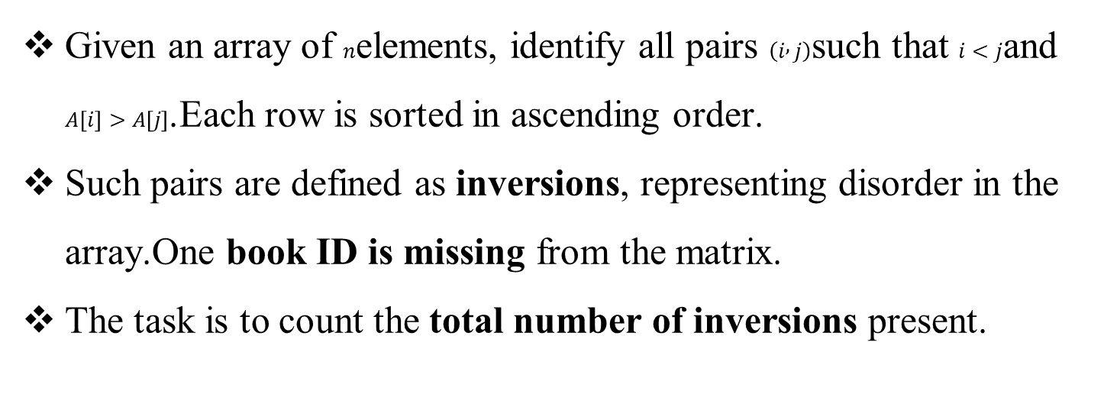
PROBLEM STATEMENT
Given an array of $n$elements, identify all pairs $\left(i , j\right)$such that $i<j$and $A\left[i\right]>A\left[j\right]$.Each row is sorted in ascending order.
Such pairs are defined as inversions, representing disorder in the array.One book ID is missing from the matrix.
The task is to count the total number of inversions present.
2

Slide 3
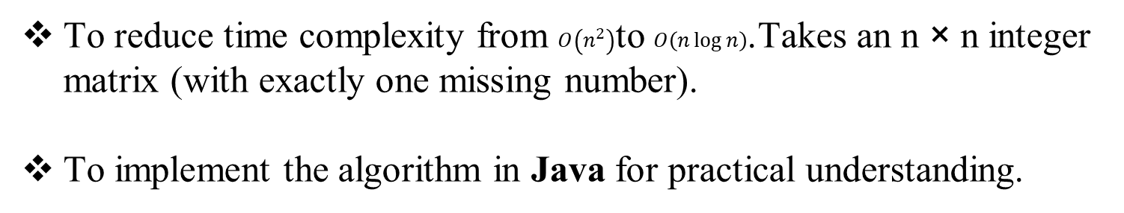
OBJECTIVE
To understand the concept of inversions in an array.
To design an efficient solution using Divide & Conquer (Merge Sort).Handle unique IDs from 1 to n² (one missing).
To reduce time complexity from $O\left(n^{2}\right)$to $O\left(n\log{n}\right)$.Takes an n × n integer matrix (with exactly one missing number).
To implement the algorithm in Java for practical understanding.
3

Slide 4
ALGORITHM DESIGN TECHNIQUE
function countInversions(arr, left, right):
if left >= right:
return 0
mid = (left + right) / 2
inv = 0
inv += countInversions(arr, left, mid)
inv += countInversions(arr, mid+1, right)
inv += mergeAndCount(arr, left, mid, right)
return inv
4

Slide 5
APPROACH
Assume matrix contains IDs from 1 to n² except one missing.
Start from matrix[0][n-1] (top-right).
Initialize expected = 1.
While within bounds:
If matrix[i][j] == expected → increment expected, move left (j--).
If matrix[i][j] < expected → move down (i++).
If matrix[i][j] > expected → missing ID = expected, stop.
If loop ends without finding mismatch, missing ID is expected.
5

Slide 6
CODING
public static void main(String[] args) {
int n = 4;
int[][] matrix = {
{1, 2, 3, 4},
{5, 6, 7, 8},
{9, 11, 12, 13},
{14, 15, 16, 0} // 0 is placeholder for missing
};
int[][] mat = {
{1, 2, 3, 4},
{5, 6, 7, 8},
{9, 11, 12, 13},
{14, 15, 16, 17} // but 17 is >16, so wrong. Let's fix.
};
int[][] validMat = {
{1, 2, 3, 4},
{5, 6, 7, 8},
{9, 11, 12, 13},
{14, 15, 16, -1} // -1 dummy, but we ignore last cell
};
int[][] testMat = {
{1, 2, 3},
{4, 6, 7},
{8, 9, -1} // -1 ignored
};
System.out.println("Missing ID: " + findMissingID(testMat, 3)); // Output: 5
}
}
public class MissingBookID {
public static int findMissingID(int[][] matrix, int n) {
int i = 0, j = n - 1;
while (i < n && j >= 0) {
int expected = i * n + j + 1;
if (matrix[i][j] == expected) {
// Move to next row in same column
i++;
} else {
// Found mismatch — missing number is expected
return expected;
}
}
// If we exit loop, missing is the last number
return n * n;
}
6

Slide 7
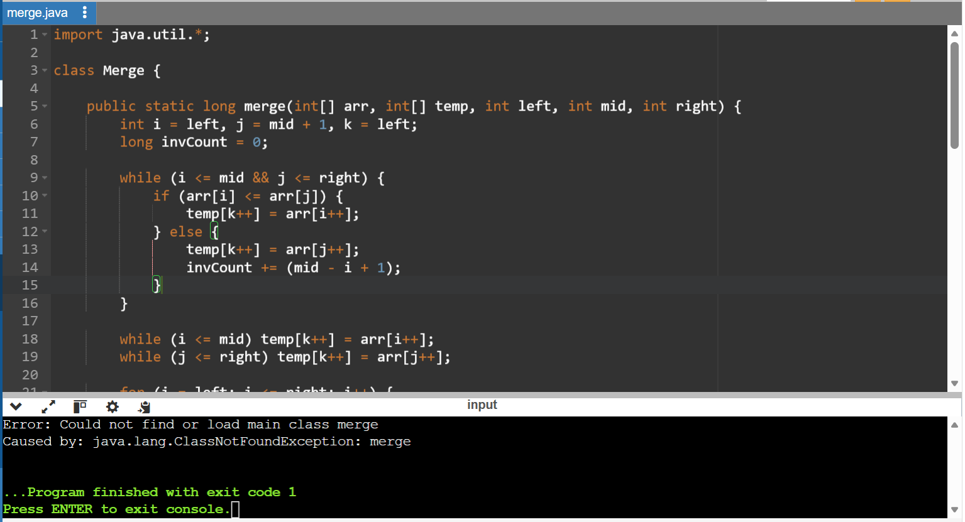
CODING OUTPUT

Slide 8
TIME COMPLEXITY DERIVATION
Let ii = row index, jj = column index. Initial: i=0i=0, j=n−1j=n−1.
In each iteration:
If matrix[i][j]=i⋅n+j+1matrix[i][j]=i⋅n+j+1 then i←i+1i←i+1
Else j←j−1j←j−1
Let dd = number of down moves, ll = number of left moves.
After mm iterations:
i=d,j=n−1−li=d,j=n−1−lm=d+lm=d+lTermination condition: i=ni=n or j=−1j=−1
Case 1: i=n⇒d=n⇒m=n+l≤n+n=2ni=n⇒d=n⇒m=n+l≤n+n=2n
Case 2: j=−1⇒n−1−l=−1⇒l=n⇒m=d+n≤n+n=2nj=−1⇒n−1−l=−1⇒l=n⇒m=d+n≤n+n=2n
Thus:
m≤2nm≤2nTime per iteration = constant cc
T(n)≤2n⋅cT(n)≤2n⋅cLower bound: Need to check at least nn positions in worst case ⇒T(n)≥c⋅n⇒T(n)≥c⋅n
Therefore:
T(n)=Θ(n)T(n)=Θ(n)

Slide 9
CONCLUSION
Decrease-and-conquer efficiently solves the missing element problem in a sorted matrix.
Achieves O(n) time, much faster than brute force O(n²).
Works well for library systems, database integrity checks, and sorted data validation.
The top-right start technique is optimal for row-wise & column-wise sorted matrices.

Slide 10
THANK YOU

